Slide 1
18ECO134T – Sensors and Transducers
Unit III : Session 5 : SLO 5
SRM Institute of Science and Technology
Notes:
Pl use Font Family : Arial Narrow
To enhance the teacher presentations and the overall comprehension of students, it allows to present their lessons in a more dynamic and effective way. Set a Learning Objective:
1. Write an Outline for Key Ideas
2. Give the Presentation About Education a "Why"
3. Share Techniques and Tips for the Topic
4. Teach With Visualizations
5. Use Animations Carefully

Slide 2
PYROELECTRIC THERMAL SENSOR-Introduction

Slide 3
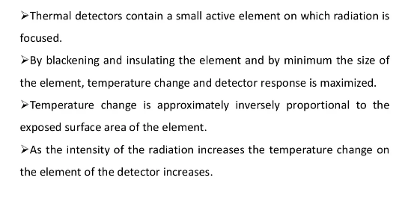
Introduction

Slide 4
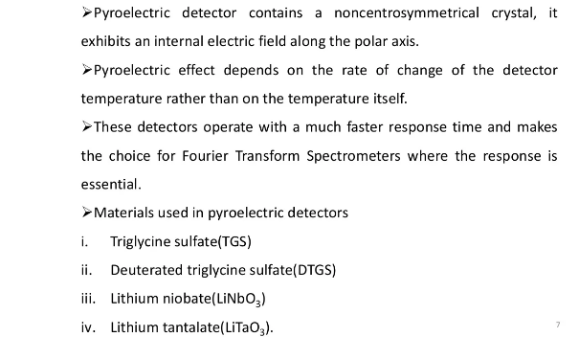
Principle

